Slide 1



Customer Sentiment Analysis

Slide 2


OBJECTIVE
As a Data Analyst at Flipkart, analyze customer sentiment towards the iPhone 15 128GB model by evaluating reviews using sentiment analysis. The goal is to gain insights into public perception, identify product strengths and weaknesses, and support decision-making.

Slide 3

ABOUT US
The iPhone 15 is a smartphone developed and marketed by Apple, succeeding the iPhone 14. It was announced on September 12, 2023, and released on September 22, 2023. The iPhone 15 features a durable design with color-infused glass and aluminum, and is splash, water, and dust resistant. It also boasts a 6.1-inch Super Retina XDR display, a 48MP main camera, and the A16 Bionic chip.

Slide 4

TASK
1. Data Collection (Web Scraping):
Tool: Selenium and BeautifulSoup
Task: Scrape at least 300 customer reviews from Flipkart's product page for the iPhone 15 128GB model. Each review should include:
Username: The name of the reviewer.
Rating: The rating provided by the user (1 to 5 stars).
Review Text: The content of the customer's review, which may contain valuable information regarding their experience with the product.
Add a subheading

Slide 5
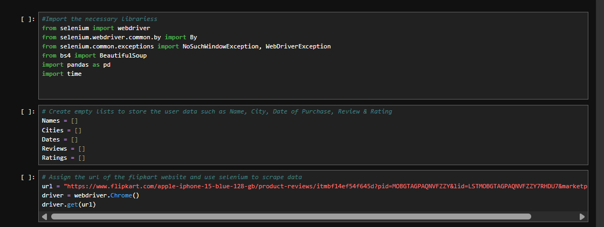
Steps:
Set up Selenium to automate browser interactions, navigate to Flipkart’s product page for iPhone 15 128GB, and extract the reviews.
Use BeautifulSoup to parse the HTML of the reviews and extract the relevant details (username, rating, and review text).
Ensure that the scraper handles pagination to retrieve reviews from multiple pages if necessary.

Slide 6

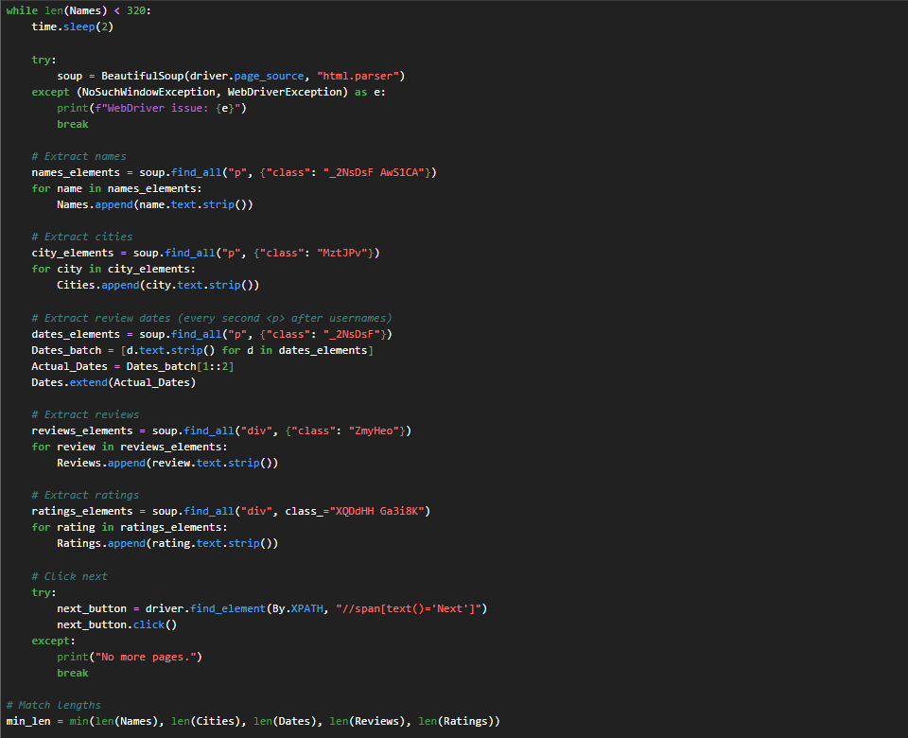

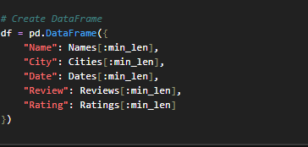


Slide 7
2. Data Cleaning and Preprocessing:
Tool: Pandas
Task: Clean and preprocess the scraped data for analysis.
Steps:
Remove duplicates: Eliminate any duplicate reviews to ensure data quality.
Handle missing values: Address missing or incomplete data, such as missing review text or rating, by either removing rows or filling in missing values if applicable.
Text preprocessing:
Convert the review text to lowercase.
Remove irrelevant characters (e.g., special characters, punctuation, and extra spaces).
Tokenize the text into individual words.
Remove stop words (commonly used words that do not add significant meaning to sentiment analysis).
Perform lemmatization to convert words into their base form (e.g., "running" → "run").

Slide 8
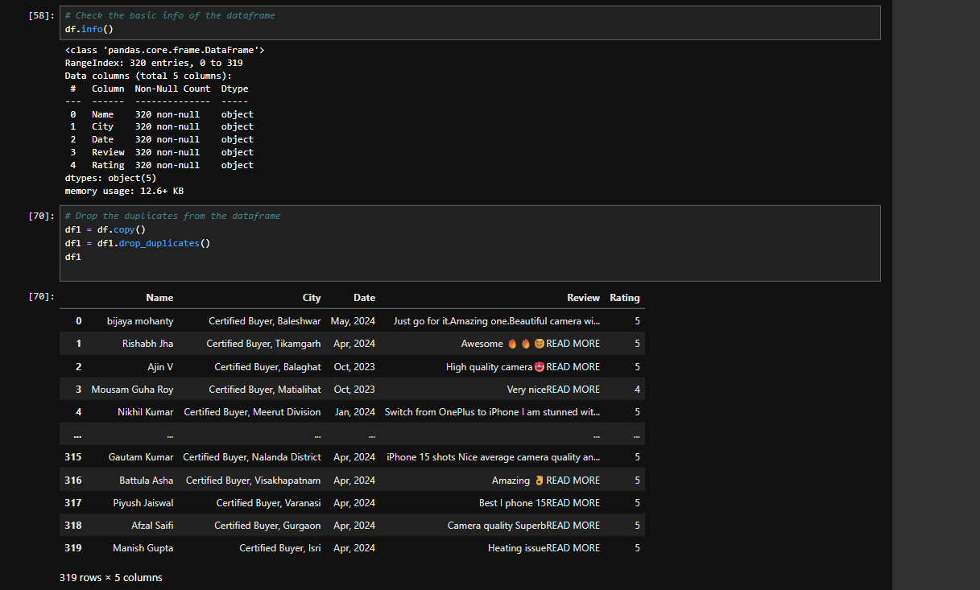

Slide 9
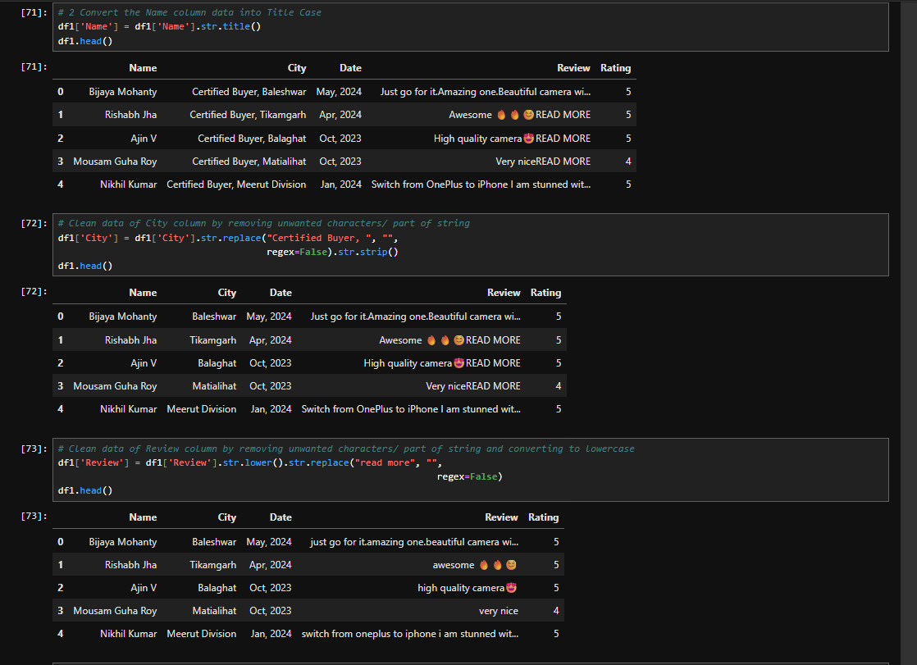

Slide 10
3. Sentiment Analysis:
Tool: TextBlob
Task: Analyze the sentiment of each review to classify them as either positive or negative.
Steps:
Use TextBlob to perform sentiment analysis on the review text.
TextBlob will provide a polarity score between -1 (negative) and +1 (positive), as well as a subjectivity score.
Define a threshold to classify the sentiment:
Positive sentiment: Polarity score ≥ 0.1
Negative sentiment: Polarity score < 0.1
Store the sentiment classification for each review in the dataset.

Slide 11
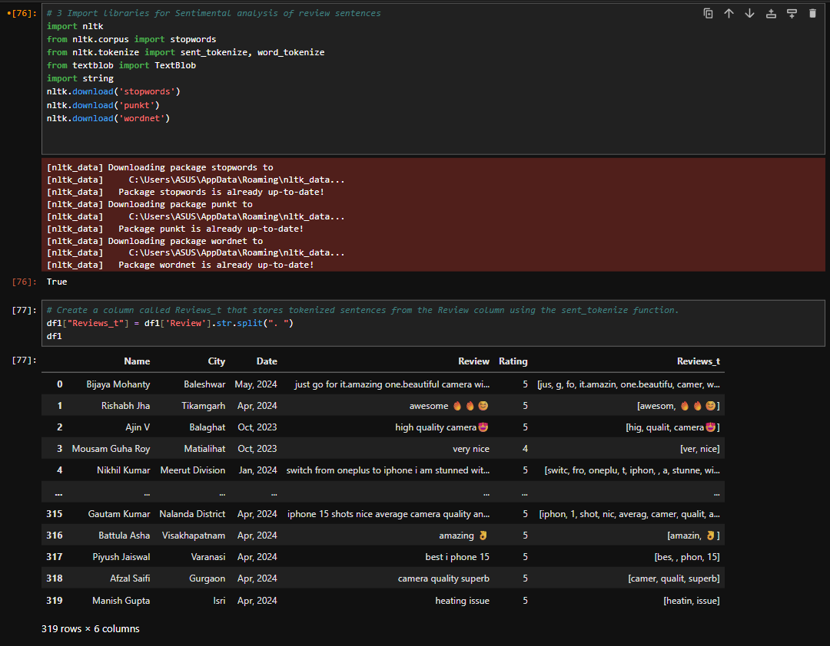

Slide 12
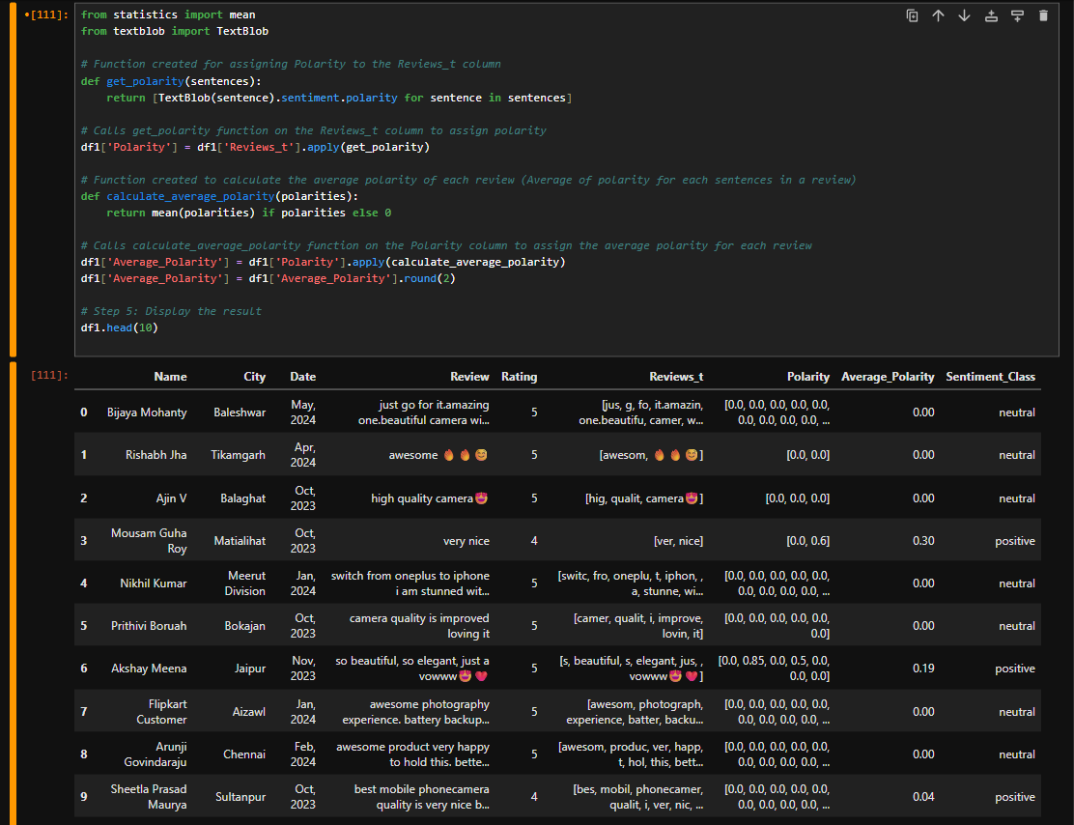

Slide 13
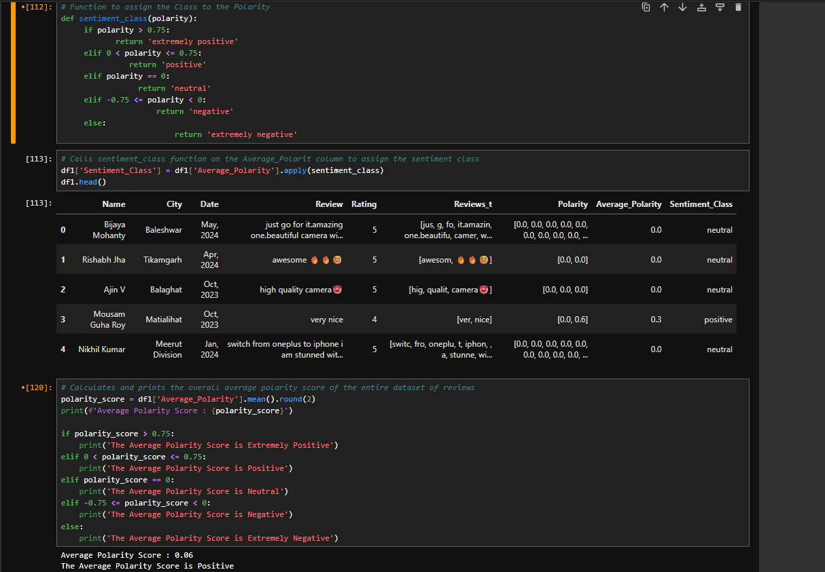

Slide 14
4. Data Analysis and Insights:
Tool: Pandas and Matplotlib/Seaborn for visualization
Task: Perform an analysis on the sentiment of reviews and extract actionable insights.
Steps:
Sentiment Distribution: Calculate the overall distribution of positive and negative sentiments for the 300 reviews.
Average Rating vs Sentiment: Analyze if there is any correlation between the numeric ratings (1-5 stars) and sentiment polarity. Do higher ratings correspond with more positive sentiments?
Word Cloud: Create a word cloud to identify the most frequently mentioned words in the positive and negative reviews.
Review Length Analysis: Investigate if longer reviews are associated with more detailed sentiments, either positive or negative.

Slide 15
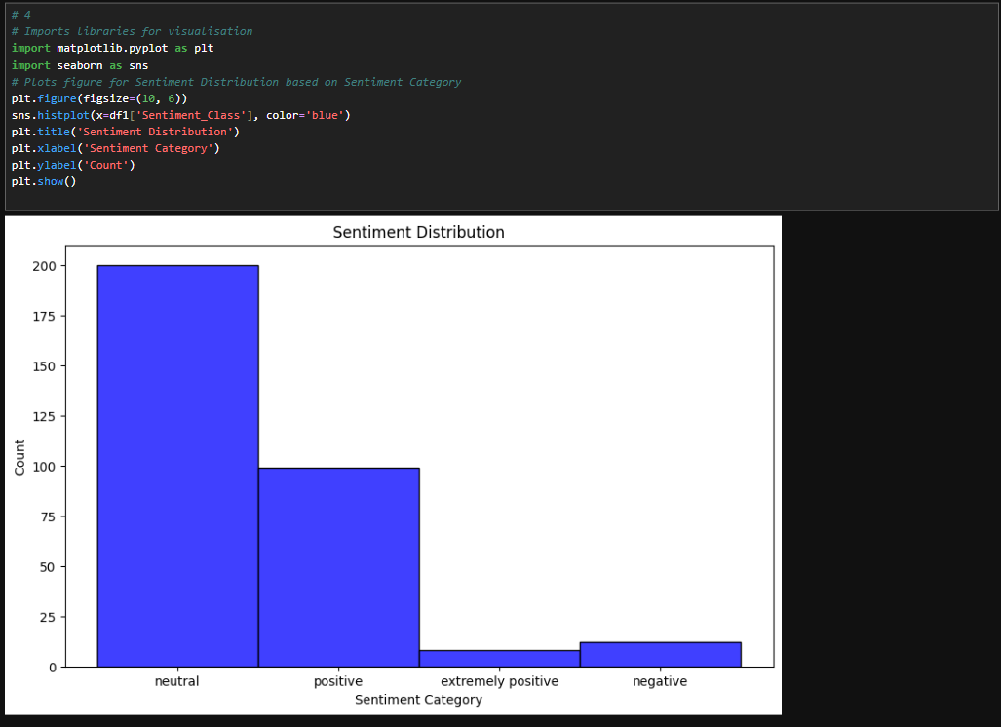

Slide 16
summery
Sentiment Distribution
The majority of the reviews are neutral, suggesting users are neither highly satisfied nor dissatisfied.
A good number are positive, which is a good sign.
Negative and extremely positive reviews are rare, showing extremes are uncommon.
Bar Chart Interpretation
Each bar represents the number of reviews that fall into each sentiment category:
Sentiment Category Approx. Count Interpretation
neutral ~200 Majority of users gave balanced/mixed reviews.
positive ~100 A significant number had a positive opinion.
extremely positive ~10 Very few users were extremely satisfied.
negative ~15 Very few users had negative experiences.

Slide 17
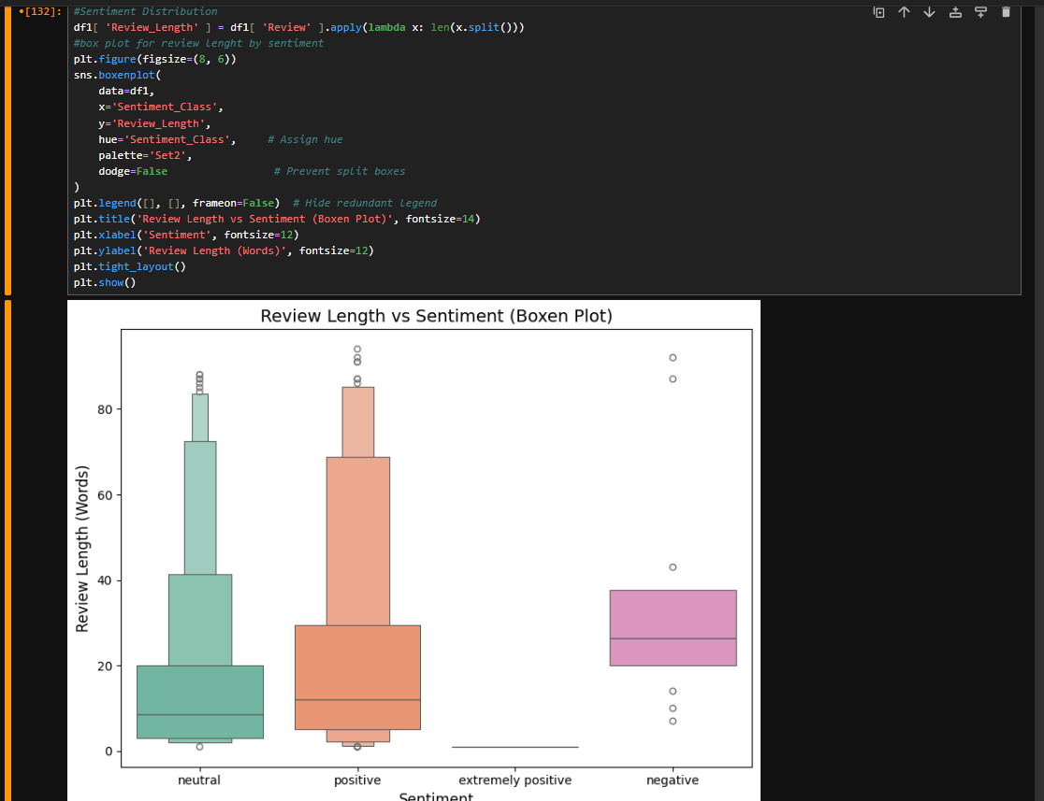

Slide 18
summery
Observation:
Reviews with strong positive sentiment tend to correlate with higher ratings, particularly in the range of 4.5 to 5 stars.
Interpretation:
This suggests that:
Neutral language doesn't always equate to a neutral experience.
Users may assign ratings based on factors not expressed in the text.
Sentiment analysis tools may miss subtle cues, leading to ambiguous classification.
There is a moderate to strong correlation between review sentiment and star ratings:
Positive text = High rating
Negative text = Low rating
Neutral text = Mixed outcomes
This reinforces the value of combining sentiment analysis with ratings to better understand user satisfaction.

Slide 19
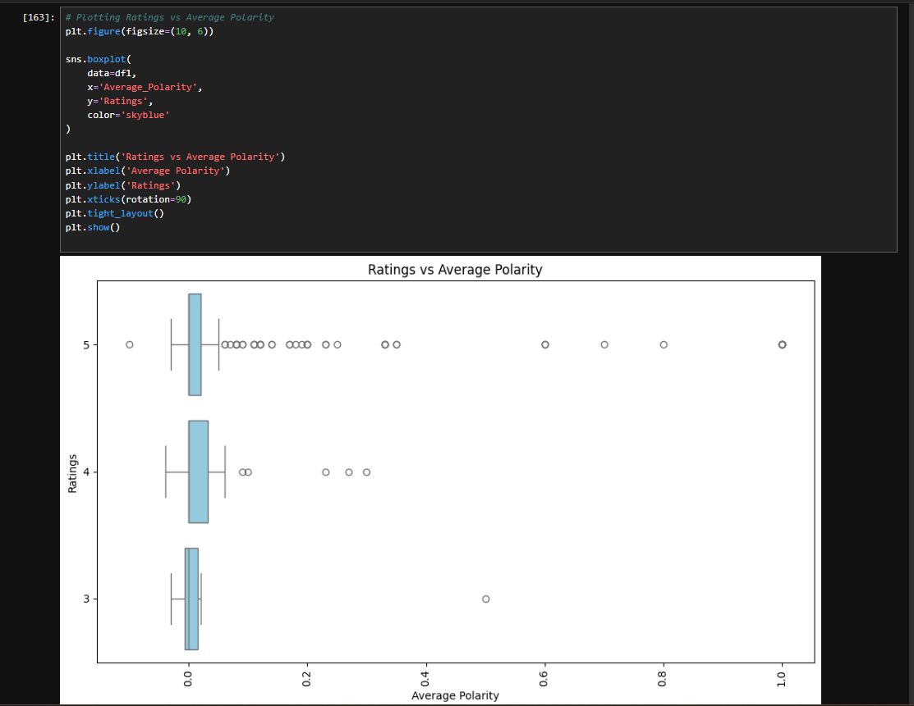

Slide 20
summery
✅ 1. Positive Sentiment
Observation:
Shows the widest variation in review lengths, indicating a broad range of user experiences.
There are several outliers, suggesting some users write very long detailed reviews.
The median review length is higher than all other sentiment groups.
Interpretation:
Positive reviewers tend to elaborate more, possibly to explain why they liked the product.
They are often engaged and expressive, giving more nuanced feedback.
2. Extremely Positive Sentiment
Observation:
Has the shortest overall review lengths.
The distribution is tight with fewer outliers.
Interpretation:
Users expressing extreme positivity often use short, enthusiastic responses (e.g., “Amazing!”, “Love it!”).
Indicates high satisfaction without the need for detailed explanations.
⚪ 3. Neutral Sentiment
Observation:
Shows a narrow and compact distribution of review lengths.
Similar pattern to “Extremely Positive” but slightly more varied.
Interpretation:
Neutral reviews are brief and factual, lacking emotional depth.
Users may describe basic functionality without expressing strong opinions.
4. Negative Sentiment
Observation:
Displays a moderate range of review lengths.
The median length is shorter than Positive, but longer than Extremely Positive and Neutral.
Interpretation:
Negative reviewers may focus on specific complaints, keeping their messages direct and concise.
Some may provide detail (e.g., delivery issues or product defects), but in general, they get to the point quickly.
Overall Interpretation
Positive Sentiment = Longer, more detailed reviews.
Extremely Positive & Neutral Sentiment = Short and straightforward.
Negative Sentiment = Variable length, but typically more concise than positive.
This pattern suggests that:
Happy customers love to share their experiences.
Neutral or very happy users often write quick feedback.
Unhappy customers express concerns briefly unless highly dissatisfied.

Slide 21
5. Reporting:
Summarize the findings in a clear, concise report with the following sections:
Overview of the data collection and cleaning process.
Sentiment Analysis Results: Distribution of positive/negative reviews, average sentiment per rating, etc.
Insights: Key trends from the sentiment analysis, such as common issues with the product or positive highlights.
Recommendations: Based on customer sentiment, suggest improvements for the iPhone 15 128GB model or potential areas Flipkart can focus on for marketing.
Libraries and Tools:
Selenium: For automating the web scraping process.
BeautifulSoup: For parsing HTML and extracting review details.
Pandas: For data cleaning, processing, and analysis.
TextBlob: For performing sentiment analysis on the review text.
Matplotlib/Seaborn: For visualizations like sentiment distribution and word clouds.

Slide 22
Sentiment Analysis Report
Customer Reviews of the iPhone 15 (128 GB) on Flipkart
1. Data Collection and Cleaning Process
• Data Source: Customer reviews for the iPhone 15 (128 GB, Blue) were extracted from Flipkart using web scraping tools: - Selenium (to interact with the dynamic website) - BeautifulSoup (to parse the HTML content) • Data Preparation: - Removed unwanted characters, special symbols, and HTML tags. - Standardized review text formatting and stripped extra spaces. - Tokenization: Split text into meaningful components for analysis. - Performed sentiment classification into 5 categories: Negative, Neutral, Positive, Extremely Positive, Extremely Negative - Used TextBlob to derive sentiment polarity scores.
2. Sentiment Analysis Findings
Sentiment Breakdown: • Majority of the reviews fell into the Positive and Extremely Positive categories. • Neutral and Negative sentiments made up a smaller portion, indicating general customer satisfaction. Sentiment by Rating: • 5-star ratings were strongly associated with positive or extremely positive reviews. • 1–2 star ratings commonly reflected neutral or negative sentiment, often tied to specific issues.
3. Key Insights
Positive Aspects Identified: • Design: Modern, slim, and premium build. • Camera Quality: Mentioned as a standout feature across many reviews. • Performance: Smooth, responsive user experience with high processing speed. • Battery Life: Several customers praised the improved battery performance.

Slide 23
Common Complaints: • Pricing Concerns: Perceived as high by some customers. • Delivery Issues: Minor complaints regarding packaging quality or delayed shipments. • Compatibility: A few users mentioned accessory compatibility problems. • Software Glitches: Minor but noticeable bugs were flagged by some users.
4. Recommendations
Product Enhancements: • Address software bugs raised by customers to improve user satisfaction. • Investigate accessory compatibility concerns and update product documentation or packaging accordingly. Marketing Suggestions: • Highlight camera performance, battery improvements, and sleek design in future campaigns. • Use real customer quotes or review snippets in ads to build trust. • Offer pricing flexibility: - EMI options - Exchange deals - Limited-time promotional discounts Operational Improvements: • Improve packaging standards to prevent minor damage during delivery. • Reduce delivery delays by tightening logistics and improving communication with shipping partners. • Regularly monitor customer feedback to identify and fix emerging issues promptly.

Slide 24
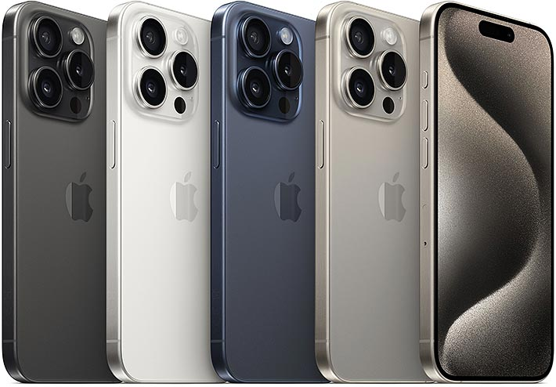
CTRL + CLICK FOR GITHUB LINK

Slide 25
THANK YOU FOR WATCHING
CREAT BY : JAYDEEP PRAJAPATI

